Slide 1
Kit Harington
Plesu Catalin

Slide 2
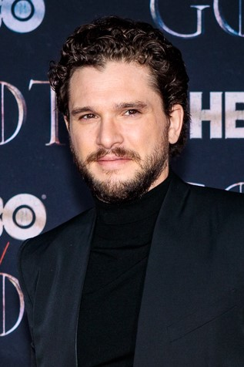
Christopher Catesby Harington, known professionally as Kit Harington, is an English actor and producer. Born in Acton, Greater London, Harington studied at the Royal Central School of Speech & Drama. While still at drama school, he made his professional acting debut with the lead role of Albert Narracott in the critically acclaimed West End play War Horse at the National Theatre.

Slide 3
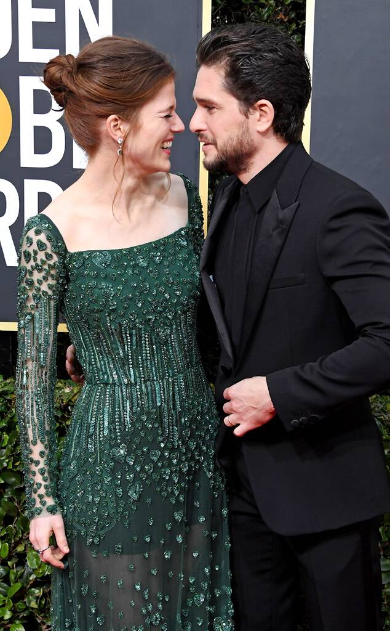
Harington began a relationship with his Game of Thrones co-star Rose Leslie in 2011. They announced their engagement through the 'Forthcoming Marriages' section of The Times on 27 September 2017.
On 23 June 2018, the couple married at Rayne Parish Church in Aberdeenshire, Scotland, followed by a reception at the Wardhill Castle.[69] In September 2020, Leslie posed for a magazine photo shoot visibly pregnant.
In May 2019, Harington checked into a mental health and wellness facility to seek help for some personal problems.

Slide 4
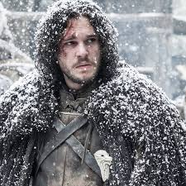
In 2011, Harington rose to prominence for his breakthrough role as Jon Snow in the HBO fantasy television series Game of Thrones (2011–2019), which brought him international recognition and several accolades, including a Golden Globe nomination for Best Actor – Television Series Drama in 2019 and two Primetime Emmy Award nominations for Outstanding Supporting Actor in a Drama Series in 2016 and Outstanding Lead Actor in a Drama Series in 2019.

